Slide 1
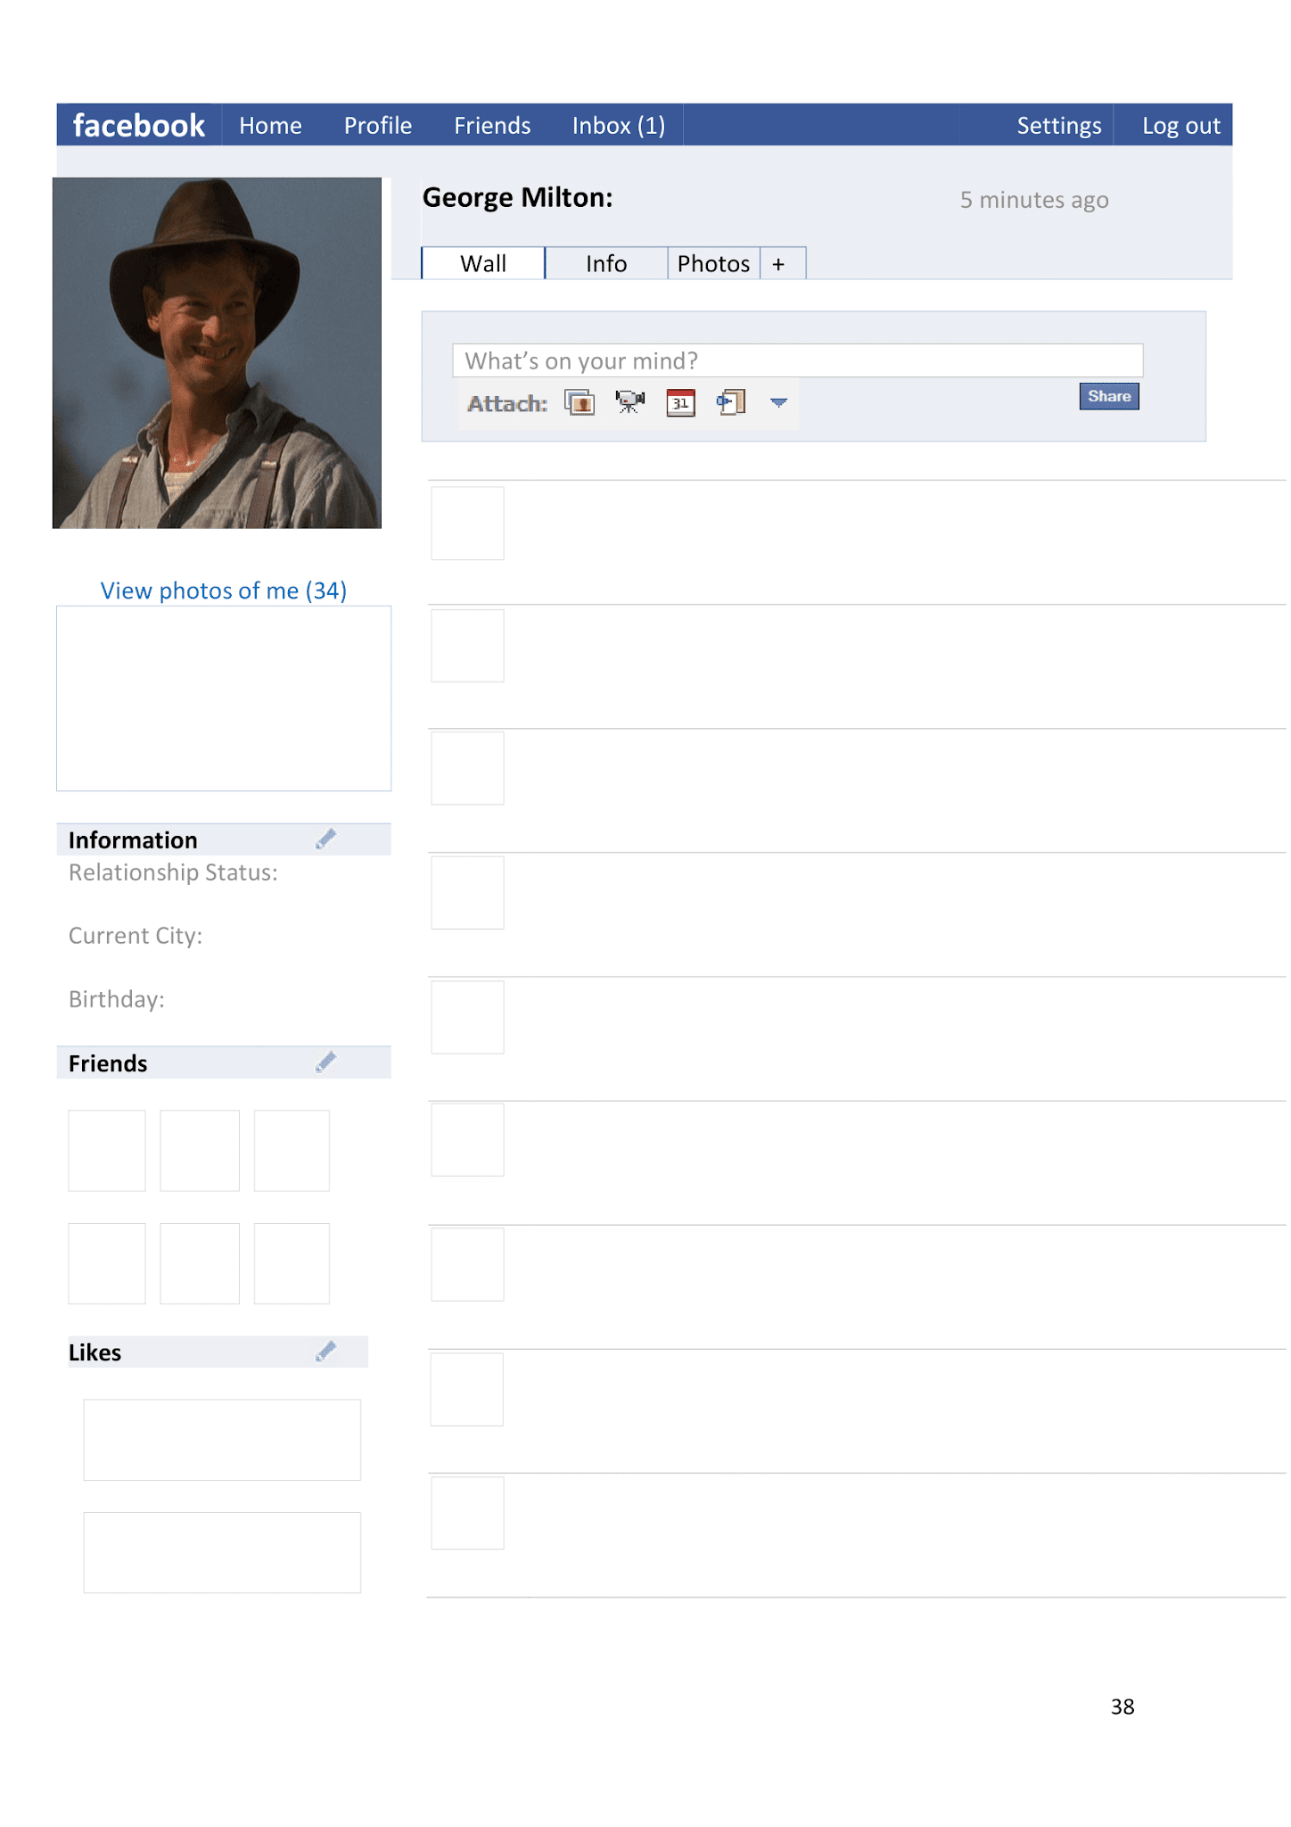



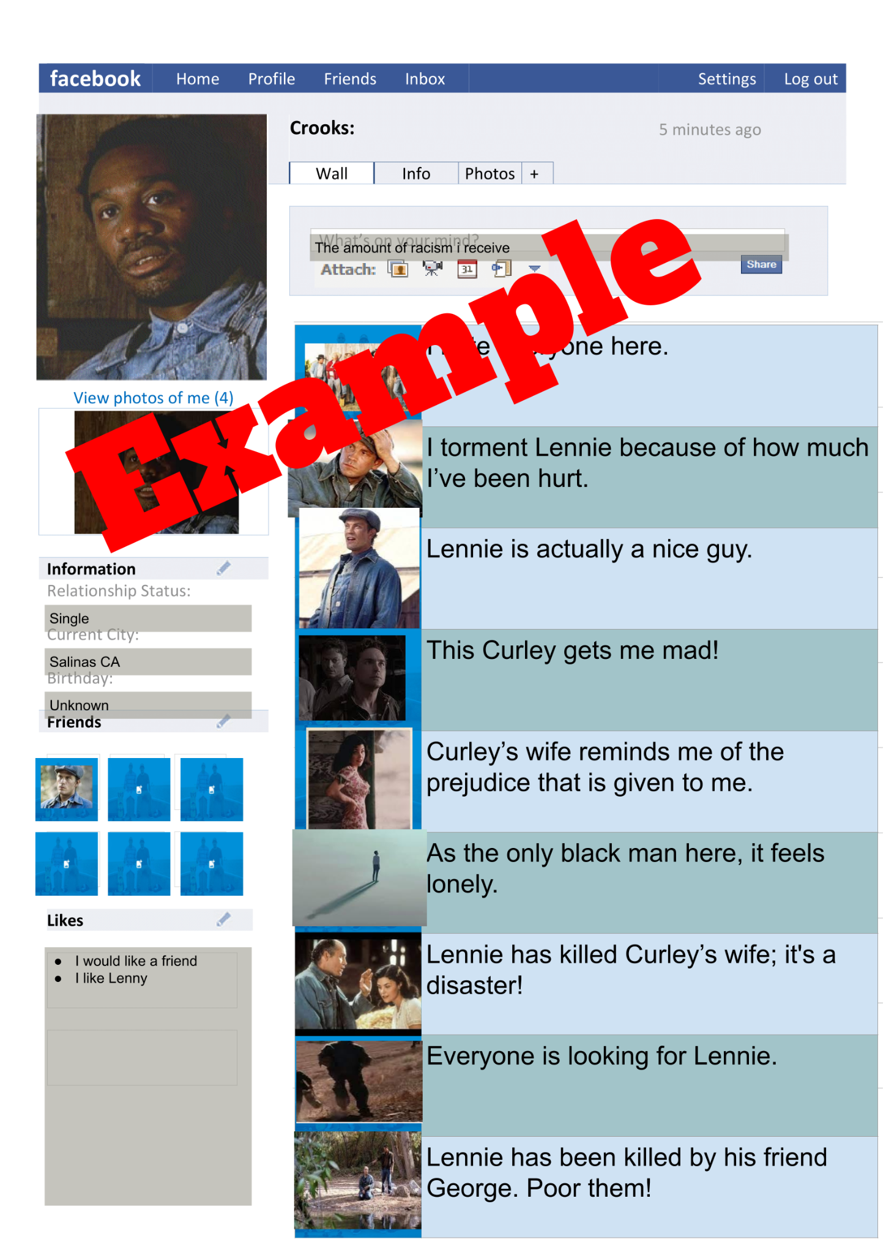





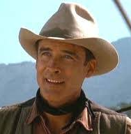
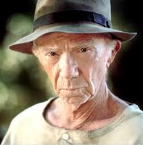
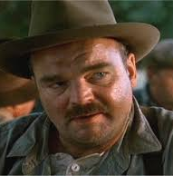

Complete this information to the best of your ability.
Post a compelling status update.
Use these and/or other pictures you find to add appropriate characters to this character’s “Friends” list.
Insert text
Having a hard time reading something?
Remember, you can zoom in on any part of this document. Just use the zoom button. The little dropdown arrow next to it has an option called “zoom in.”
 | Insert text
 | Insert text
 | Insert text
 | Insert text
 | Insert text
 | Insert text
 | Insert text
 | Insert text
 | Insert text
George
Lennie
Curley
Curley’s Wife
Crooks
Slim
Candy
Carlson
The Boss
Insert text
Insert text
Insert text
Or you can click the zoom button and then click and drag the area you want to zoom in. That way, it’s zoomed to exactly the part you need! And you can always zoom out by choosing “fit” in the zoom dropdown menu.
Insert text
Insert text
Insert text

Slide 2
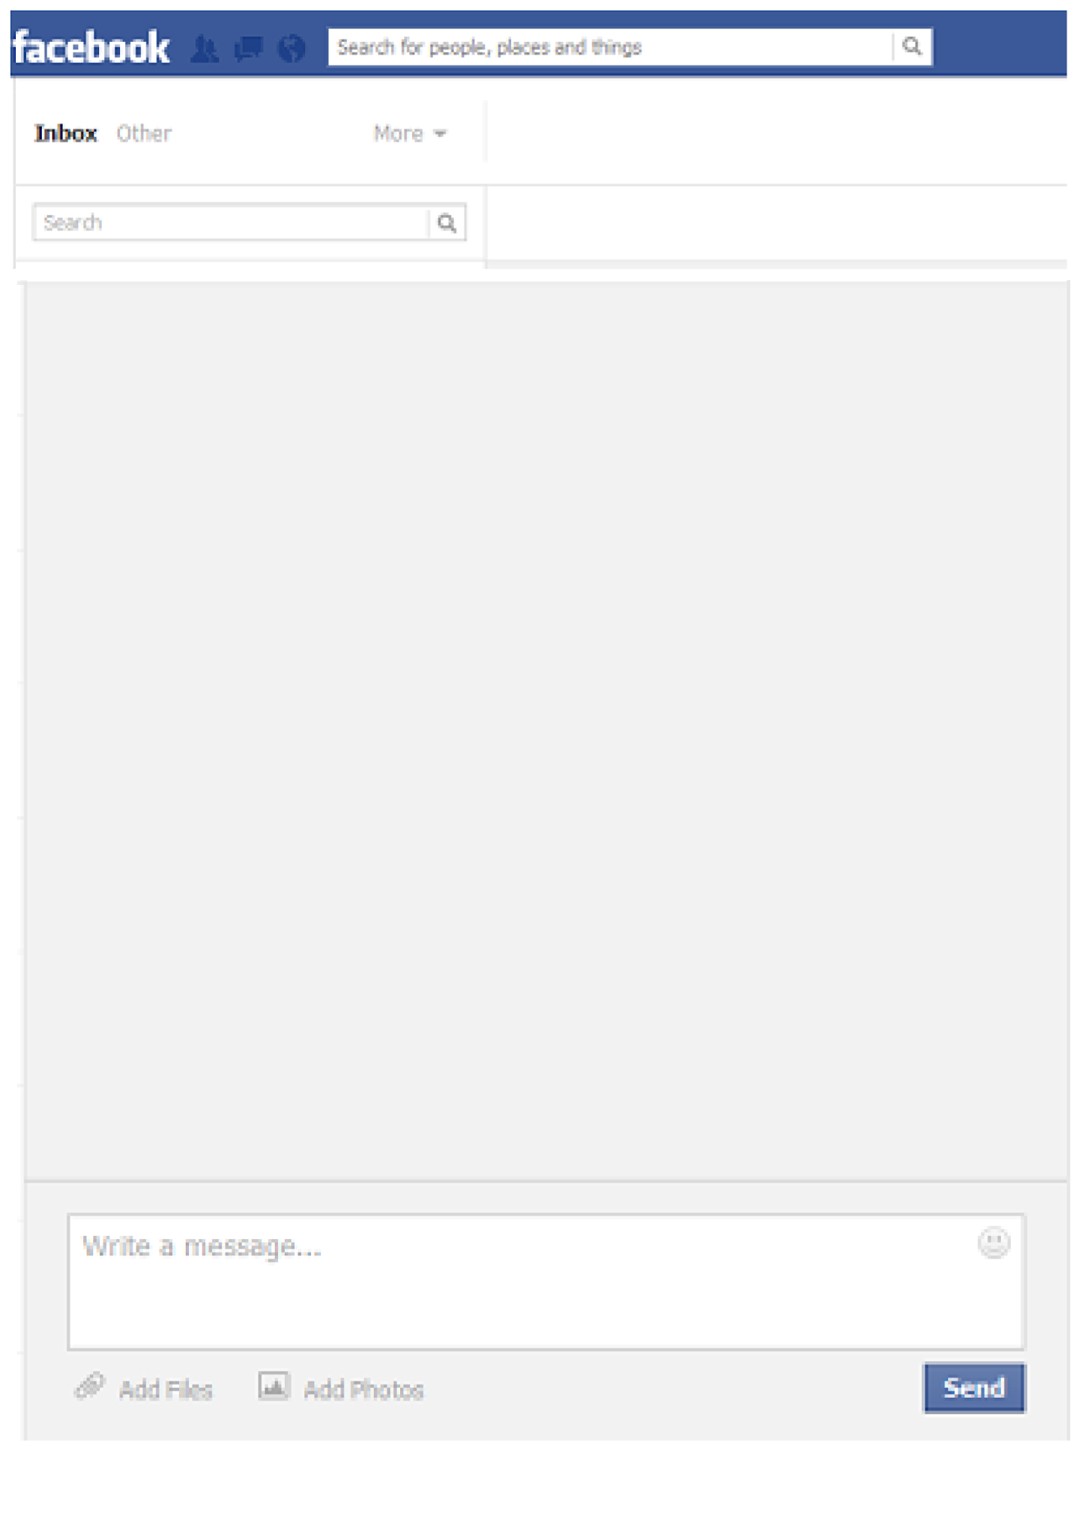

From:
Who is writing to this character?
What did they write?
Insert text
Insert text
What did your character write back?

